Slide 1
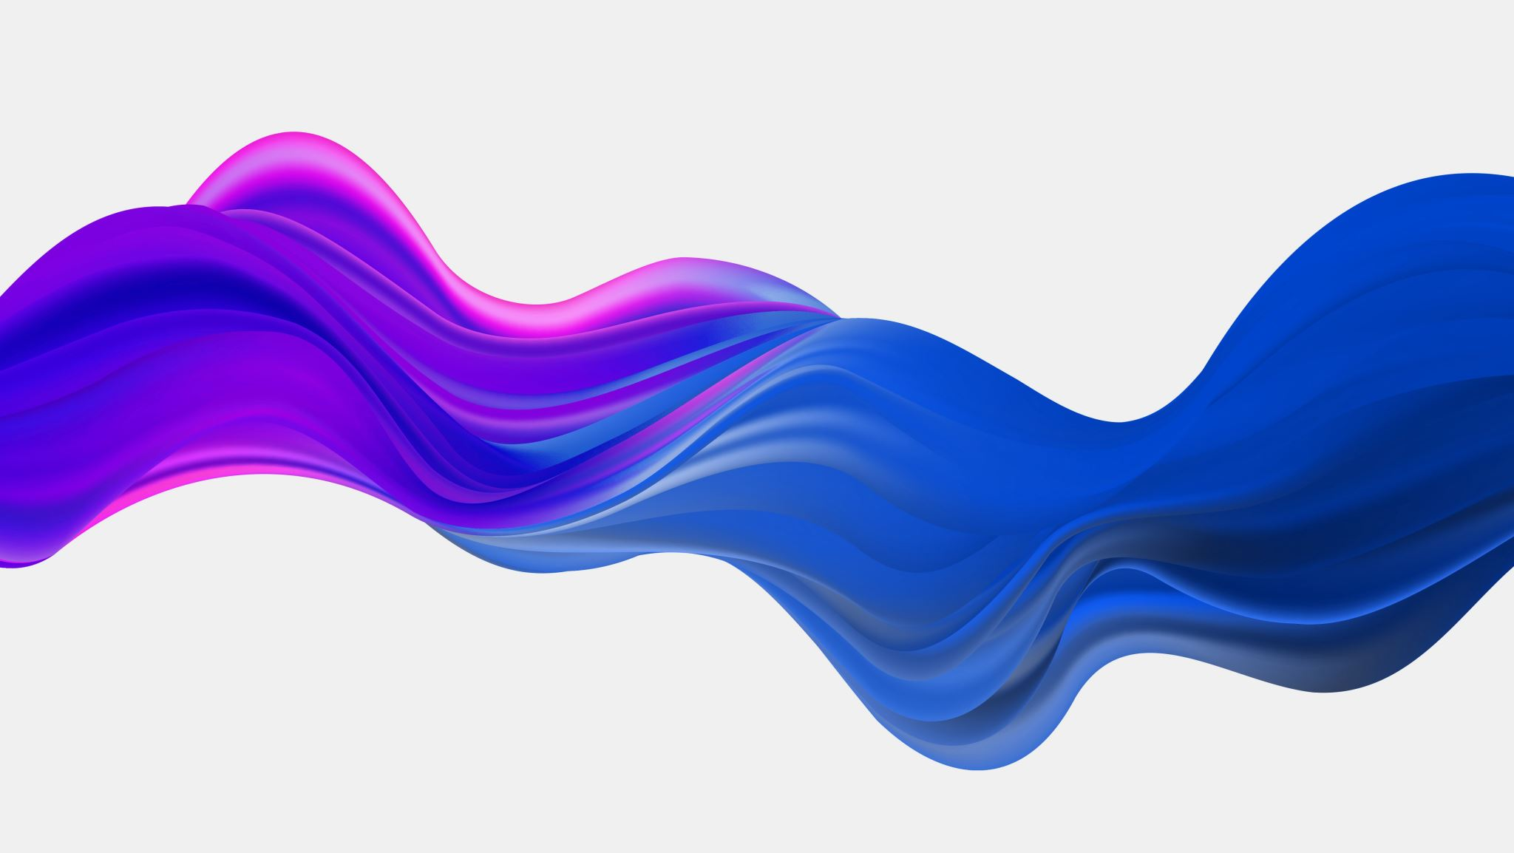
Aaron Sherwood
Kavin Balakrishnan DES INV 23 8/3/20

Slide 2
About
Interactive media artist
Creates large sculptures and dynamic art installations
Mediums of sound and light
Interactive
Creates large scale performances
Places people at the center of his artworks
Showcases
Coachella Arts Festival
Burning Man Arts Festival
Google
Brooklyn Museum of Art

Slide 3

Works

Slide 4
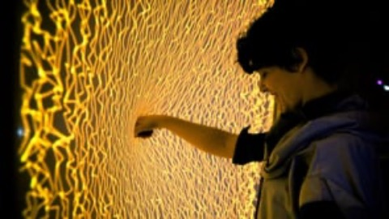
Firewall
Interactive art piece
User interacts with membrane to create various sounds
Distortions create variation in sounds and light patterns
User can play music

Slide 5

Magnetophone
Musical Instrument
Played with electromagnets
Different patterns are formed using the strings

